Slide 1
Computer Organization & Design
Hardware Software Interface
Xiaohong Jiang

Slide 2
Recap
The jal instruction is used to jump to the procedure and
save the current PC (+4) into the return address register
Arguments are passed in $a0-$a3; return values in $v0-$v1
Since the callee may over-write the caller’s registers,
relevant values may have to be copied into memory
Each procedure may also require memory space for
local variables – a stack is used to organize the memory
needs for each procedure

Slide 3
Memory Organization
The space allocated on stack by a procedure is termed the activation record (includes saved values and data local to the procedure)
frame pointer points to the start of the record and stack pointer points to the end – variable addresses are specified relative to $fp as $sp may change during the execution of the procedure
$gp points to area in memory that saves global variables
Dynamically allocated storage (with malloc()) is placed on the heap
Stack
Dynamic data (heap)
Static data (globals)
Text (instructions)

Slide 4
2.9 Communicating with People Beyond Numbers
ASCII ( American Standard Code for Information Interchange )
Instructions for moving bytes in MIPS
Load byte ( lb ): lb $t0, 0($sp) # read byte from source
Store byte ( sb ): sb $t0, 0($sp) # write byte to destination
Three choices for representing a string
Place the length of the string in the first position
An accompanying variable has the length
A character in the last position to mark the end of a string
C uses the third choice
Terminate a string with a byte whose value is 0 ( null in ASCII )

Slide 5
Example 2.17
Convert to assembly:
int strcpy (char x[], char y[])
{
int i;
i=0;
while ((x[i] = y[i]) != `\0’)
i += 1;
return i;
}
Assuming:
$a1: starting address of y[i]
$a0: starting address of x[i]
$s0: i

Slide 6
Example
Convert to assembly:
int strcpy (char x[], char y[])
{
int i;
i=0;
while ((x[i] = y[i]) != `\0’)
i ++;
return i
}
strcpy:
addi $sp, $sp, -4
sw $s0, 0($sp)
add $s0, $zero, $zero
L1: add $t1, $s0, $a1
lb $t2, 0($t1)
add $t3, $s0, $a0
sb $t2, 0($t3)
addi $s0, $s0, 1
bne $t2, $zero, L1
addi $v0, $s0, -1
lw $s0, 0($sp)
addi $sp, $sp, 4
jr $ra
Assuming:
$a1: starting address of y[i]
$a0: starting address of x[i]
$s0: i

Slide 7
2.10 MIPS Addressing for 32-Bit Immediate and Addresses
32-Bit Immediate addressing
most constants is short and fit into 16-bit field
How to deal with immediate longer than 16 bits?

Slide 8
Large Constants
Immediate instructions can only specify 16-bit constants
The lui instruction is used to store a 16-bit constant into the upper 16 bits of a register… thus, two immediate instructions are used to specify a 32-bit constant
The destination PC-address in a conditional branch is specified as a 16-bit constant, relative to the current PC
A jump (j) instruction can specify a 26-bit constant; if more bits are required, the jump-register (jr) instruction is used

Slide 9
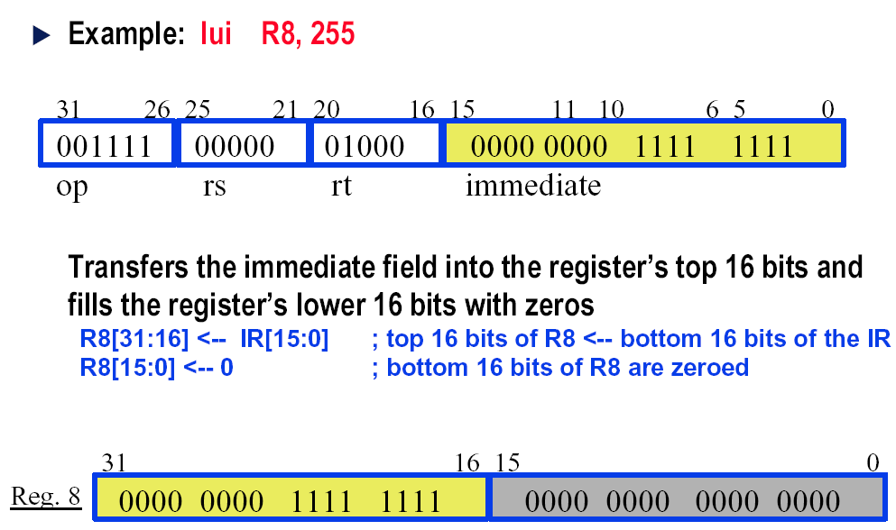
Load Upper Immediate

Slide 10
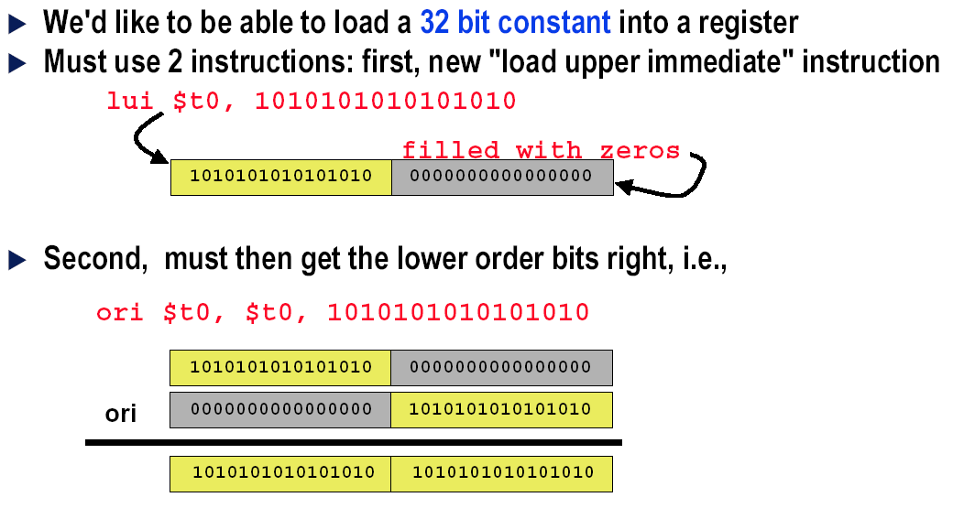
Larger Constants?

Slide 11
Addressing in branches and jumps
For jumps: J-format
j 10000 # go to location 10000
| 2 | 10000 |
6 bits 26 bits
Pseudo-direct addressing
26 bits of the instruction concatenated with the upper 4 bits of PC
For branches:
bne $s0, $s1, Exit # go to Exit if $s0 != $s1
| 5 | 16 | 17 | Exit |
6 bits 5 bits 5 bits 16 bits
PC-relative addressing
PC = (PC + 4) + Branch address
Why?

Slide 12
Ex 2.20 Show branch offset in machine
C language: while (save[i]==k) i=i+j; MIPS assembler code in Example 2.12:
Loop: add $t1, $s3, $s3 # temp reg $t1 = 2 * i
add $t1, $t1, $t1 # temp reg $t1 = 4 * i
add $t1, $t1, $s6 # $t1 = address of save[i]
lw $t0, 0($t1) # temp reg $t0 = save[i]
bne $t0, $s5, Exit # go to Exit if save[i] != k
add $s3, $s3, $s4 # i = i + j
j Loop # go to Loop
Exit:
Assume: $s6 save the starting address of array save .
$s5 keep the value of K.

Slide 13
How about PC offset is larger than 16 bits ?
Assembled instructions and their addresses:
80000 | 0 | 19 | 19 | 9 | 0 | 32 |
80004 | 0 | 9 | 9 | 9 | 0 | 32 |
80008 | 0 | 9 | 22 | 9 | 0 | 32 |
80012 | 35 | 9 | 8 | 0 |
80016 | 5 | 8 | 21 | 2 (8) |
80020 | 0 | 19 | 20 | 19 | 0 | 32 |
80024 | 2 | 20000 (80000) |
80028 . . .
Modification:
All MIPS instructions are 4 bytes long
PC-relative addressing refers to the number of words
The address field at 80016 above should be 2 instead of 8
add
add
add
Lw
bne
add
j
PC+4+offset=80020 + 8

Slide 14
Branching far away
Example 2.21
Given a branch:
beq $s0, $s1, L1
Rewrite it to offer a much greater branching distance:
bne $s0, $s1, L2
j L1
L2:
While branch target is far away
Inserts an unconditional jump to target
Invert the condition so that the branch decides whether to skip the jump

Slide 15
MIPS addressing mode summary
Register addressing:
add $s0, $s0, $s0
Base or displacement addressing:
lw $s1, 0($s0)
Immediate addressing:
addi $s0,$s0, 4
PC-relative addressing:
beq $s0,$s1, L1 PC+4+L1
Pseudodirect addressing:
j Address1
[PC+4](31..28) ##Address1

Slide 16
Five MIPS addressing modes

Slide 17
Ex 2.22 Decoding machine code
Machine instruction
( Bits: 31 28 26 5 2 0 )
0000 0000 1010 1111 1000 0000 0010 0000
Decoding
Determine the operation from opcode
op: 000000 → R-format instruction
op rs rt rd shamt funct
| 000000 | 00101 | 01111 | 10000 | 00000 | 100000 |
5 15 16 add
Determine other fields
rs: $a1; rt: $t7; rd: $s0 P88
Show the assembly instruction
add $s0, $a1, $t7 (Note: add rd,rs,rt)
$zero 0
$at 1
$v0-$v1 2-3
$a0-$a3 4-7
$t0-$t7 8-15
$s0-$s7 16-23
$t8-$t9 24-25
$k0-$k1 26-27
$gp 28
$sp 29
$fp 30
$ra 31

Slide 18
Summary of MIPS architecture in Chapter 2 P105
MIPS instruction format
| Name | Fields | Comments |
| Field size | 6 bits| 5 bits| 5 bits| 5 bits| 5 bits| 6 bits| All MIPS instructions 32 bits |
| R-format | op | rs | rt | rd |shamt| funct | Arithmetic instruction format |
| I-format | op | rs | rt | address/immediate | Transfer,branch,imm. format |
| J-format | op | target address | Jump instruction format |
MIPS operands
| Name | Example |
| 32 registers | $s0~$s7, $t0~$t9,$zero, $a0~$a3, $v0~$v1, $gp $fp, $gp, $ra, $at |
| Mem words | Memory[0], Memory[4], . . . , Memory[4294967292] |
MIPS assembly language
ALU
add add $s1, $s2, $s3
subtract sub $s1, $s2, $s3
add immediate addi $s1, $s2, -3 (Note: subi does not exist)

Slide 19
Data transfer
load word lw $s1, 100($s2)
store word sw $s1, 100($s2)
load byte lb $s1, 100($s2)
store byte sb $s1, 100($s2)
load upper immediate lui $s1, 100
Conditional branch
branch on equal beq $s1, $s2, 25
branch on not equal bne $s1, $s2, 25
set on less than slt $s1, $s2, $s3
set on less than immediate slti $s1, $s2, 100
Unconditional jump
jump j 2500
jump register jr $ra
jump and link jal 2500

Slide 20
Tips on Assembler
Principle：
It’s not requisite to obey the conventions
Example
Jump back from procedure instead of using Jr ra
Jump into or out of a procedure directly.
What could you do if there are more than 4 parameters for the procedure?
Push the parameters into the stack before Jal and then pop it out in the procedure.
Use free register to transfer the parameter

Slide 21
Compilers & the SPIM Simulator
SPIM is a simulator that reads in an assembly program
and models its behavior on a MIPS processor
Note that a “MIPS add instruction” will eventually be
converted to an add instruction for the host computer’s
architecture – this translation happens under the hood
To simplify the programmer’s task, it accepts
pseudo-instructions, large constants, constants in
decimal/hex formats, labels, etc.
The simulator allows us to inspect register/memory
values to confirm that our program is behaving correctly

Slide 22
Example
This simple program (similar to what we’ve written in class) will run
on SPIM (a “main” label is introduced so SPIM knows where to start)
main:
addi $t0, $zero, 5
addi $t1, $zero, 7
add $t2, $t0, $t1
If we inspect the contents of $t2, we’ll find the number 12

Slide 23
User Interface
rajeev@trust > spim
(spim) read “add.s”
(spim) run
(spim) print $10
Reg 10 = 0x0000000c (12)
(spim) reinitialize
(spim) read “add.s”
(spim) step
(spim) print $8
Reg 8 = 0x00000005 (5)
(spim) print $9
Reg 9 = 0x00000000 (0)
(spim) step
(spim) print $9
Reg 9 = 0x00000007 (7)
(spim) exit
File add.s
main:
addi $t0, $zero, 5
addi $t1, $zero, 7
add $t2, $t0, $t1

Slide 24
Directives
File add.s
.text
.globl main
main:
addi $t0, $zero, 5
addi $t1, $zero, 7
add $t2, $t0, $t1
…
jal swap_proc
jr $ra
.globl swap_proc
swap_proc:
…
Stack
Dynamic data (heap)
Static data (globals)
Text (instructions)
This function is visible to other files

Slide 25
Directives
File add.s
.data
.word 5
.word 7
.byte 25
.asciiz “the answer is”
.text
.globl main
main:
lw $t0, 0($gp)
lw $t1, 4($gp)
add $t2, $t0, $t1
…
jal swap_proc
jr $ra
Stack
Dynamic data (heap)
Static data (globals)
Text (instructions)

Slide 26
Labels
File add.s
.data
in1 .word 5
in2 .word 7
c1 .byte 25
str .asciiz “the answer is”
.text
.globl main
main:
lw $t0, in1
lw $t1, in2
add $t2, $t0, $t1
…
jal swap_proc
jr $ra
Stack
Dynamic data (heap)
Static data (globals)
Text (instructions)

Slide 27
Endian-ness
Two major formats for transferring values between registers and memory
Memory: low address 45 7b 87 7f high address
Little-endian register: the first byte read goes in the low end of the register
Register: 7f 87 7b 45
Most-significant bit Least-significant bit
Big-endian register: the first byte read goes in the big end of the register
Register: 45 7b 87 7f
Most-significant bit Least-significant bit

Slide 28
System Calls
SPIM provides some OS services: most useful are
operations for I/O: read, write, file open, file close
The arguments for the syscall are placed in $a0-$a3
The type of syscall is identified by placing the appropriate
number in $v0 ( li $v0, 1–10), “1-10” means one of the
OS service ID number
for example: 1 for print_int, 4 for print_string, 5 for read_int
$v0 is also used for the syscall’s return value

Slide 29
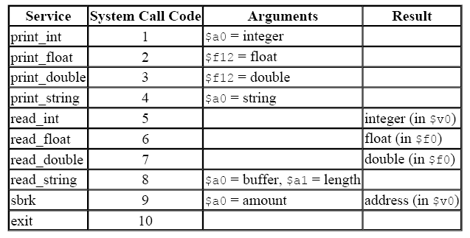
System call

Slide 30
Example Print Routine
.data
str: .asciiz “the answer is ”
.text
li $v0, 4 # load immediate; 4 is the code for print_string
la $a0, str # the print_string syscall expects the string
# address as the argument; la is the instruction
# to load the address of the operand (str)
syscall # SPIM will now invoke syscall-4
li $v0, 1 # syscall-1 corresponds to print_int
li $a0, 5 # print_int expects the integer as its argument
syscall # SPIM will now invoke syscall-1

Slide 31
Example
Write an assembly program to prompt the user for two numbers and
print the sum of the two numbers

Slide 32
Answer for Example
.text .data
.globl main str1: .asciiz “Enter 2 numbers:”
main: str2: .asciiz “The sum is ”
li $v0, 4
la $a0, str1
syscall # print str1 on screen
li $v0, 5
syscall # read in 1st integer
add $t0, $v0, $zero # $t0 ← 1st input integer
li $v0, 5
syscall # read in 2nd integer
add $t1, $v0, $zero # $t1 ← 2nd input integer
li $v0, 4
la $a0, str2
syscall # print str2 on screen
li $v0, 1
add $a0, $t1, $t0
syscall # print $t0+$t1 on screen

Slide 33
2.12 Translating and starting a Program
C Program
x.c
A translation hierarchy
Compiler
Assembly language program
x.s
Assembler
x.o
x.a, x.so
Object: machine language module
Object: library routine (machine language)
Linker
Executable: machine language program
a.out
Loader
Memory

Slide 34
Role of Assembler
Convert pseudo-instructions into actual hardware
instructions – pseudo-instrs make it easier to program
in assembly – examples: “move”, “blt”, 32-bit immediate
operands, etc.
Convert assembly instructions into machine instructions
a separate object file (x.o) is created for each C file (x.c)
compute the actual values for instruction labels
maintain info on external references and debugging information

Slide 35
Role of Linker
Stitches different object files into a single executable
patch internal and external references
determine addresses of data and instruction labels
organize code and data modules in memory
Some libraries (DLLs) are dynamically linked – the
executable points to dummy routines – these dummy
routines call the dynamic linker-loader so they can
update the executable to jump to the correct routine

Slide 36
Compilation Steps
The front-end: deals mostly with language specific actions
Scanning: reads characters and breaks them into tokens
Parsing: checks syntax
Semantic analysis: makes sure operations/types are
meaningful
Intermediate representation: simple instructions,
infinite registers, makes few assumptions about hw
The back-end: optimizations and code generation
Local optimizations: within a basic block
Global optimizations: across basic blocks
Register allocation

Slide 37
Compiler: Dataflow
Control flow graph: each box represents a basic block and
arcs represent potential jumps between instructions
For each block, the compiler computes values that were
defined (written to) and used (read from)
Such dataflow analysis is key to several optimizations:
for example, moving code around, eliminating dead code,
removing redundant computations, etc.

Slide 38
Compiler: Register Allocation
The IR contains infinite virtual registers – these must be mapped to
the architecture’s finite set of registers (say, 32 registers)
For each virtual register, its live range is computed (the range
between which the register is defined and used)
We must now assign one of 32 colors to each virtual register so that
intersecting live ranges are colored differently – can be mapped to the
famous graph coloring problem
If this is not possible, some values will have to be temporarily spilled
to memory and restored (this is equivalent to breaking a single live
range into smaller live ranges)

Slide 39
Compiler: High-Level Optimizations
High-level optimizations are usually hardware independent
Procedure inlining
Loop unrolling
Loop interchange, blocking (more on this later when we
study cache/memory organization)

Slide 40
Compiler: Low-Level Optimizations
Common sub-expression elimination
Constant propagation
Copy propagation
Dead store/code elimination
Code motion
Induction variable elimination
Strength reduction
Pipeline scheduling

Slide 41
Start a C program in a file on disk to run
object file
Compiling
C program → assembly language program
Assembling
Assembly language program → machine language module
pseudoinstructions
move $t0,$t1 # register St0 gets register $t1
add $t0,$zero, $t1 # register St0 gets 0+register $t1
Symbol table
A table that matches name of lables to the addresses of the memory words that instructions occupy.

Slide 42
Object file of UNIX (six distinct pieces)
object file header—size and position of the other pieces
Text segment
static data segment and dynamic data
The relocation information ----identifies absolute addresses of instruction and data words when the program is loaded into memory
Symbol table
Debugging information
Object file header
 | Name | Procedure A
 | Text size | 100_{hex}
 | Data size | 20_{hex}
Text segment | Address | instruction
 | 0 | lw $a0, 0($gp)
 | 4 | jal 0
 | …… | --
Data segment | 0 | (X)
 | …… | ……
Relocation information | Address | Instruction type | Dependency
 | 0 | Lw | X
 | 4 | jal | B
Symbol table | label | Address
 | X | --
 | B | --

Slide 43
Linking
Object modules(including library routine) → executable program
3 step of Link
Place code and data modules symbolically in memory
Determine the addresses of data and instruction labels
Patch both the internal and external references (Address of invoke)
$sp
7fff fffc_{hex}
Stack
Link object file A & B
0000000000000000 0111111111111111 + 2¹⁵
0001000000000000 1000000000000000
1111111111111111 1000000000000000 -2¹⁵
Dynamic data
+
1000 8000_{hex}
$gp
Static data
0001000000000000 0000000000000000
1000 0000_{hex}
Text
PC
0040 0000_{hex}
Reserved
0

Slide 44
Loading
Determine size of text and data segments
Create an address space large enough
Copy instructions and data from executable file to memory
Copy parameters (if any) to the main program onto the stack
Initialize registers and set $sp to the first free location
Jump to a start-up routine

Slide 45
2.13 A C Sort Example to Put it All Together
3 steps for translating C procedures
Allocate registers to program variables
Produce code for the body of the procedures
Preserve registers across the procedures invocation

Slide 46
Procedure swap (C code)
swap ( int v[ ] , int k )
{
int temp ;
temp = v[ k ] ;
v[ k ] = v[ k + 1 ] ;
v[ k + 1 ] = temp ;
}

Slide 47
The swap Procedure swap (v, j);
Why use $a0, $a1 for V and j ?
Register allocation:
$a0 and $a1 for the two arguments,
$t0 for the temp variable – no need for saves and restore
this is a leaf procedure (won’t need to reuse $a0 and $a1)
swap: sll $t1, $a1, 2 ;$t1←j*4
add $t1, $a0, $t1 ;$t1←v[j] address = v + j*4
lw $t0, 0($t1) ; $t0← v[j]
lw $t2, 4($t1) ; $t2← v[j+1]
sw $t2, 0($t1) ; v[j] ← $t2
sw $t0, 4($t1) ; v[j+1] ←$t0
jr $ra

Slide 48
Full Example – Sort in C
void sort (int v[], int n)
{
int i, j;
for (i=0; i<n; i+=1) {
for (j=i-1; j>=0 && v[j] > v[j+1]; j-=1) {
swap (v,j);
}
}
}
If V[0]> V[1]
V[0]
V[1]
V[2]
……
V[n-1]
void swap (int v[], int k)
{
int temp;
temp = v[k];
v[k] = v[k+1];
v[k+1] = temp;
}

Slide 49
Procedure sort
If V[0]> V[1]
V[0]
V[1]
V[2]
……
V[n-1]
C code
sort ( int v[ ] , int n )
{
int i , j ;
for ( i = 0 ; i < n ; i + = 1 ) {
for ( j = i - 1 ; j >= 0 && v[j] > v[j+1] ; j- = 1 )
swap ( v , j ) ;
}
}
Register allocation for sort
v ---- $a0 n ---- $a1 i ---- $s0 j ---- $s1
Passing parameters in sort
Preserving registers in sort
$ra , $s0, $s1, $s2, $s3

Slide 50
Code for the procedure sort
Saving registers
sort: addi $sp, $sp, -20 # make room on stack for 5 registers
sw $ra, 16($sp) # save $ra on stack
sw $s3, 12($sp) # save $s3 on stack
sw $s2, 8($sp) # save $s2 on stack
sw $s1, 4($sp) # save $s1 on stack
sw $s0, 0($sp) # save $s0 on stack
Procedure body{Outer loop {Inner loop} }
Restoring registers
exit1: lw $s0, 0($sp) # restore $s0 from stack
lw $s1, 4($sp) # restore $s1 from stack
lw $s2, 8($sp) # restore $s2 from stack
lw $s3, 12($sp) # restore $s3 from stack
lw $ra, 16($sp) # restore $ra from stack
addi $sp, $sp, 20 # restore stack pointer
Procedure return
jr $ra # return to calling routine

Slide 51
Code for Procedure body
Outer loop—first for loop
for ( i = 0 ; i < n ; i + = 1 ) {
Move parameters
move $s2, $a0 # $s2 ← $a0 ($a0: base address, v)
move $s3, $a1 # $s3 ← $a1 ($a1: array size, n )
Outer loop
move $s0, $zero # $s0 ← $zero ( i = 0)
for1tst: slt $t0, $s0, $s3 # test if $s0 >= $s3 (i >= n)
beq $t0, $zero, exit1 # go to exit1 if $s0 >= $s3 (i >= n)
………………
（body of first for loop is second for loop）
………………
exit2: addi $s0, $s0, 1 # i = i + 1
j for1tst # jump to test of outer loop
exit1:

Slide 52
Inner loop--
sort ( int v[ ] , int n )
{
int i , j ;
for ( i = 0 ; i < n ; i + = 1 ) {
for ( j = i - 1 ;
j >= 0 && v[j] > v[j+1] ;
j- = 1 )
swap ( v , j ) ;
}
}
second for loop is body of first for loop
addi $s1, $s0, -1 # j = i - 1
for2tst: slti $t0, $s1, 0 # test if j < 0
bne $t0, $zero, exit2 # go to exit2 if j < 0
sll $t1, $s1, 2 # $t1 = j * 4
add $t2, $s2, $t1 # $t2 = the address of v[j]
lw $t3, 0($t2) # $t3 = v[j]
lw $t4, 4($t2) # $t4 = v[j + 1]
slt $t0, $t4, $t3 # test if v[j+1]>=v[j]
beq $t0, $zero, exit2 # go to exit2 if v[j+1]>=v[j]
………………
（body of first for loop ）
………………
addi $s1, $s1, -1 # j = j - 1
j for2tst # jump to test of inner loop
exit2:

Slide 53
body of first for loop
Pass parameters and call
move $a0，$s2 # $a0←$s2 ($s2 : v )
move $a1，$s1 # $a1←$s1 ($a1← j)
Call function swap(int v[], int k)
jal swap # ($a0 might be changed in swap)
Notice: 1.Why are $a0 and $a1 saved? $a0 is the base of the array v. $a0 will be used repeatedly and might be(actually not here) changed by the procedure swap. $a1 is the size of the array v. $a1 will be used repeatedly and changed before the procedure swap is called.
2.Why are they not pushed to stack?
Register variable is faster

Slide 54
Relative Performance
Gcc optimization Relative Cycles Instruction CPI
performance count
none 1.00 159B 115B 1.38
O1 2.37 67B 37B 1.79
O2 2.38 67B 40B 1.66
O3 2.41 66B 45B 1.46
A Java interpreter has relative performance of 0.12, while the
Jave just-in-time compiler has relative performance of 2.13
Note that the quicksort algorithm is about three orders of
magnitude faster than the bubble sort algorithm (for 100K elements)

Slide 55
2.14 Arrays versus Pointers
Array version
clear1 ( int array[ ], int size )
{
int i;
for ( i = 0 ; i < size ; i = i + 1 )
array[i] = 0;
}
Pointer version
clear2 ( int *array, int size )
{
int *p;
for ( p = &array[0] ; p < &array[size] ; p = p + 1 )
*p = 0;
}

Slide 56
Assembly code(array version)
Assembly code for clear-1 procedure
move $t0, $zero # i = 0
loop1: sll $t1, $t0, 2 # $t1 = i * 4
add $t2, $a0, $t1 # $t2 = address of array[ i ]
sw $zero, 0($t2) # array[ i ] = 0
addi $t0, $t0, 1 # i = i +1
slt $t3, $t0, $a1 # test if i < size
bne $t3, $zero, loop1 # if ( i < size ) go to loop1
jr $ra
This code works as long as size is greater than 0. (In this case, the loop will be executed once even though the value of the size parameter is invalid. Actually, size >0 must be checked at first)

Slide 57
Assembly code ( pointer version)
Assembly code for clear-2 procedure
move $t0, $a0 # p = the start address of the array[]
sll $t1, $t1, 2 # $t1 = size * 4
add $t2, $a0, $t1 # $t2 = &array[size](address of array[size] )
loop2: sw $zero, 0($t0) # Memory[ p ] = 0
addi $t0, $t0, 4 # p = p + 4
slt $t3, $t0, $t2 # $t3 = (p < &array[size] )
bne $t3, $zero, loop2 # if ( p < &array[size] ) go to loop2
jr $ra
This code works as long as size is greater than 0.
Compare the two versions
Array version has the “multiply” and add inside loop
Pointer version reduces instructions/iteration from 6 to 4
For modern compliers, both ways are the same.

Slide 58
2.16 Real Stuff: IA-32 Instructions
The Intel IA-32
1978 intel 8086
16-bit architecture
Is not considered a general-purpose register
1980 intel 8087 floating-point coprocessor
1982 80286 extended the 8086 architecture by
Increasing Address Space to 24 bits
Manipulate the protection model
1985 80386 extended the 80286 architecture
32-bit architecture with 32-bit registers
32-bit address space
Add paging support in addition to segmented addressing
Nearly a general-purpose register machine ?

Slide 59
1989~95 Higher performance
80486 in 1989
Pentium in 1992
Pentium Pro in 1995
1997 Expand Pentium and Pentium Pro with MMX
1999 Expand Pentium with SSE(SIMD) as Pentium III
8 separate registers ,double their width to 128 bits
Add a single-precision floating-point data type
4 32-bit floating-point operations can be performed in parallel
Cache prefetch instructions
2001 Intel Pentium 4
2003 A company other than Intel enhanced the IA-32 architecture
AMD
Executing all IA-32 instructions with 64-bit Address space & data
2004 Intel capitulates and embraces AMD64

Slide 60
80x86 registers and data addressing modes
80386 extended all 16-bit registers but segment ones to 32 bits
GPR ( general-purpose register )
Addressing modes
Register indirect
Based mode with 8- or 32-bit displacement
Base plus scaled index
Base plus scaled index with 8- or 32-bit displacement
80x86 integer operations
Data movement instructions
Arithmetic and logic instructions
Control flow
String instructions

Slide 61
IA-32 Register and Data Addressing Modes
Name | Register no. | Usage
$zero | 0 | The constant value 0
$v0-$v1 | 2-3 | Values for results and expression evaluation
$a0-$a3 | 4-7 | Arguments
$t0-$t7 | 8-15 | Temporaries
$s0-$s7 | 16-23 | Saved
$t8-$t9 | 24-25 | More temporaries
$gp | 28 | Global pointer
$sp | 29 | Stack pointer
$fp | 30 | Framer pointer
$ra | 31 | Return address

Slide 62
Instruction types for ALU & data transfer
Source/destination operand type | Second source operand
Register | Register
Register | Immediate
Register | Memory
Memory | Register
Memory | Immediate

Slide 63
Some typical IA-32 Integer Operations

Slide 64
Typical 80x86 instruction format
1Byte
5Bytes
3Bytes
1Bytes
5Bytes
6Bytes

Slide 65
2.18 Concluding Remarks
Two principles of stored-program computers
Use instructions as numbers
Use alterable memory for programs
Four design principles
Simplicity favors regularity
Smaller is faster
Make the common case fast
Good design demands good compromises
MIPS instruction set

Slide 66
2.19 History of Instruction Set Development
Accumulator Architectures
Only 1 register for arithmetic instructions: accumulator
Memory-based operand-addressing mode
Example 2.23 Compiling C code to accumulator instructions
C code: A = B + C ;
Accumulator instructions:
load AddressB # Acc = Memory[AddressB], or Acc = B
add AddressC # Acc = Acc + Memory[AddressC], or Acc = B + C
store AddressA # Memory[AddressA] = Acc, or A = B + C
Extended Accumulator Architectures

Slide 67
General-Purpose Register Architectures
Register-memory architecture
80386
IBM 360
Load-store or register-register architecture
CDC 6600
MIPS
DEC’s VAX architecture
Allow any combination of registers and memory operands
Memory-memory architecture
Example 2.24 Compiling C code to memory-memory instructions
C code: A = B + C;
instructions:
add AddressA, AddressB, AddressC

Slide 68
Compact Code and Stack Architectures
Variable-length instructions
To match the varying operand specifications
To minimize code size
Stack model of execution
All registers are abandoned,so the instructions are short.
Push, pop
Example 2.25 Compiling C code to stack instructions
C code: A = B + C;
Stack instructions:
push AddressC # Top = Top+4; Stack[Top]=Memory[AddressC]
push AddressB # Top = Top+4; Stack[Top]=Memory[AddressB]
add # Stack[Top-4]= Stack[Top]+Stack[Top-4];Top=Top-4;
pop AddressA # Memoryp[AddressA]=Stack[Top]; Top=Top-4;

Slide 69
High-Level-Language Computer Architecture
Goal: hardware more like programming languages
Finally failed
Reduced Instruction Set Computer Architecture (RISC )
Fixed instruction lengths
Load-store instruction sets
Limited addressing modes
Limited operations
MIPS, Sun SPARC, Hewlett-Packard PA-RISC
IBM PowerPC, DEC Alpha

Slide 70
Static data segment
全局区（静态区）
全局变量和静态变量的存储是放在一块的
初始化的全局变量和静态变量在一块区域
未初始化的全局变量和未初始化的静态变量在相邻的另一块区域
程序结束后有系统释放
文字常量区
常量字符串就是放在这里的。
程序结束后由系统释放

Slide 71
TEXT segment
代码段
程序代码区—存放函数体的二进制代码

Slide 72
Segment fault（segfault）
Run out of memory
Heap指针遇到stack指针
越界访问内存
non-existent address
a buffer overflow
using uninitialized pointers
…

Slide 73
variable
PI存储在符号表中，无存储空间
从高级语言翻译到汇编时直接替代
PI有存储空间，在内存的数据段中，静态分配
在符号表中是常量变量，指向存储空间，不能修改值
PI有存储空间，在内存的栈中
随着PI所在函数进入运行，动态分配，从栈中指定一个空间给PI变量
在符号表中是常量变量，指向存储空间
PI无存储空间，直接在寄存器
在符号表中是寄存器变量，指向寄存器
#define PI 3
PI不是变量，不能取地址，不能赋值
PI是一个符号
汇编中直接用数值
Const int PI=3
PI是变量，能取地址，不能赋值
PI是一个符号，等同于变量地址
汇编中直接用变量地址
int PI=3; 或者 auto int PI=3;
PI是变量，能取地址，能赋值
PI是一个符号，等同于变量地址
汇编中直接用变量地址
Registor int PI=3
PI是变量，在寄存器中不能取地址，能赋值
PI是一个符号，等同于寄存器号
汇编中直接用寄存器号

